Slide 1


Tour easy
TEAM MEMBERS:
Y. RAJA REDDY (22R01A66C9)
N. PRADEEP (22R01A66A4)
V. SAJEEV (22R01A66C3)
V. ARJUN (22R01A66C4)

Slide 2
AGENDA
LITERATURE SURVEY
INTRODUCTION
BENIFITS
EXISTING SYSTEM
DRAW BACKS OF EXISTING SYSTEM
NEW PROPOSED
ADVANTAGES
REQUIREMENTS
CLASS DIAGRAM
USECASE DIAGRAM
CONCLUSION

Slide 3
Literature survey:
Technologies in Tour Guides
Natural Language Processing (NLP): NLP enables tour guides to understand and respond to user queries in natural language, making interactions more intuitive. Studies such as Jurafsky and Martin (2019) highlight the advancements in NLP techniques that allow for more accurate and context-aware responses.
Computer Vision: Computer vision technologies allow AI tour guides to recognize landmarks and provide relevant information through image processing. Goodfellow, Bengio, and Courville (2016) discuss the applications of deep learning in image recognition, which are crucial for developing visual tour guides.

Slide 4
INTRODUCTION:
This project it mainly focuses on the India’s most visited tourist places and other attractions which
the people will like.
In this website it particularly shows the most visited places in India by the People. It shows according to the state.
If the person select or choose any state it will give the details of the places which are more popular in that city or state.
Also it will show the near by Hotels, Restaurants, and other living cottages etc… with low budget and high quality it shows these things based on rating given by the people who were visited it, so based on that the person can easily find the restaurants and hotels
Also we provide a phone numbers of those hotels & restaurants so he/she can easily contact and book the hotels or restaurants.

Slide 5
BENEFITS of the project:
It is not only useful for the Indians. And also, it is useful for the other foreigners, who are coming to India to visit and see the tourist attractions and other places.
In this way, they can easily find the places which they want to visit in India.
Here we provide some options that are like attractions, adventure, devotion, parks, gardens like that. So in this way, they can select these multiple options. And based on the selection of options, It will show the results according to their options.
And we are providing the option of these hotels and restaurants. So due to that, they can easily find the restaurants and hotels to eat and stay at nights.,Without worrying .

Slide 6
EXISTING SYSTEM
Trip Advisor
Lonely Planet
Booking.com
Airbnb
Get your guide

Slide 7
Drawbacks of Existing System :-
Many travel websites provide an overwhelming amount of information, making it difficult for users to find what they need quickly.
Some sites have high service fees or hidden costs that are not apparent until the final stages of booking.
User reviews can be inconsistent or biased, and some may even be fake.
Some sites do not provide real-time updates on availability, pricing, or changes in travel conditions.
Not all travel websites offer multi-language support.
Websites with complicated navigation and cluttered interfaces can be hard to use.

Slide 8
New Proposed System:
An intuitive and clean design ensures users can easily find what they need.
No hidden fees; all costs are transparently displayed from the start.
Only genuine reviews from verified travelers are displayed.
Real-time updates on availability and pricing to avoid booking conflicts.
Updated maps where user can navigate to their destinations without any glitches.
Extensive resources including destination guides, tips, and local insights.
Support in multiple languages to cater to a global audience.
This proposed system for "Tour Easy" aims to provide a comprehensive, user-friendly, and transparent travel planning experience, addressing the shortcomings of current tour and travel websites.

Slide 9
Advantages
Easy to use, user friendly GUI
Easy-to-navigate design ensures users can quickly find and book their travel needs without frustration.
Users can create personalized travel plans that suit their unique preferences and requirements.
Genuine feedback from verified travelers helps users make informed decisions.
A platform for travelers to share experiences and tips, creating a supportive travel community.
Maps which help the traveller to navigate.
Translator helps to translate the current language to their understandable the language.

Slide 10
Requirements:-
Languages we are going to use in this website
HTML- Tells Browser how to structure and display a website it’s used as a front end development.
CSS – It describes the style of webpages.
PYHTON - Python is a popular open-source language that's easy to learn and use, and its libraries and frameworks support advanced technologies.
Java – used for building large scale high performance applications.

Slide 11
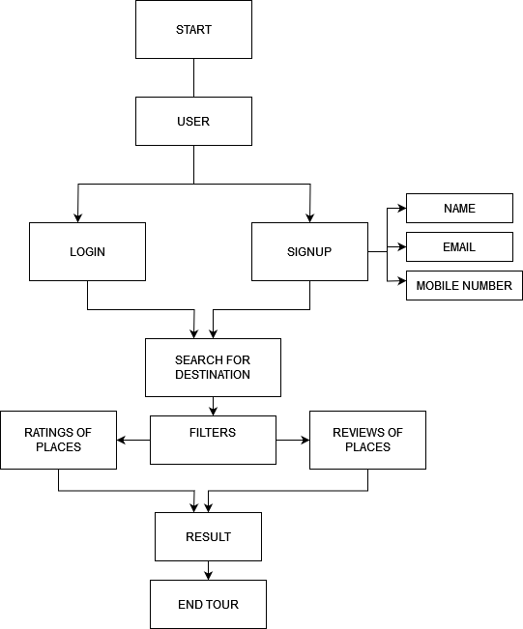
CLASS DIAGRAM

Slide 12
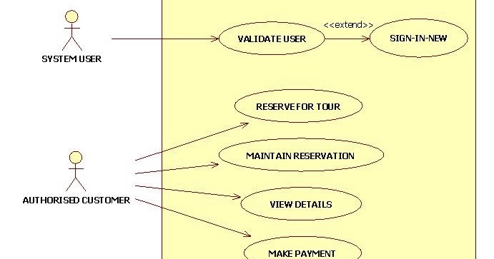
USECASE DIAGRAM

Slide 13
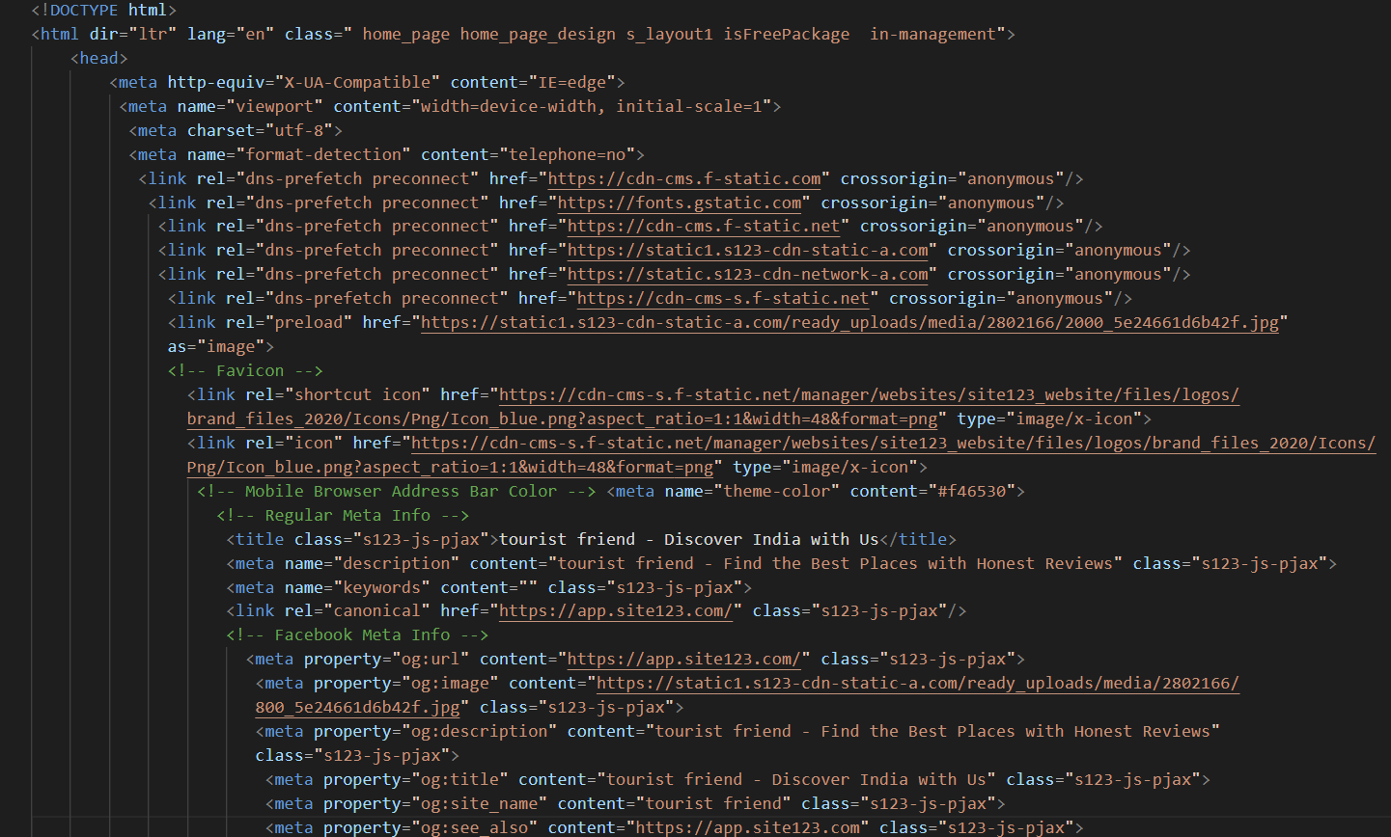
SAMPLE CODE

Slide 14
WEBSITE OVERVIEW
Search bar
At search bar we search our web site name.
Tourist Friend

Slide 15
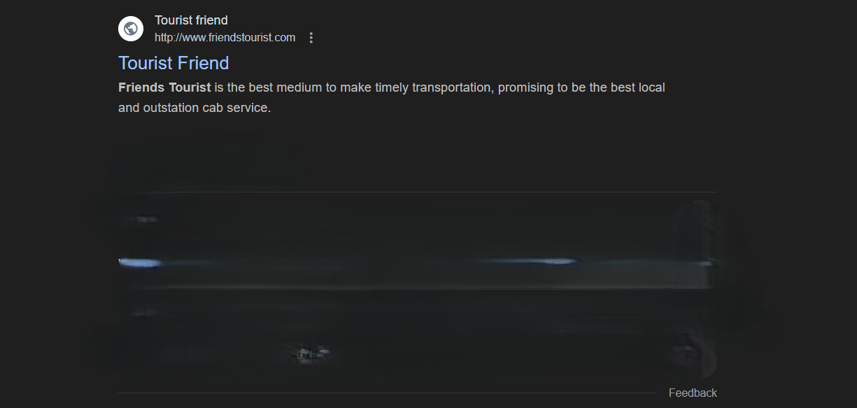
APPEARANCE
After that our website link will appear on web page

Slide 16
After clicking web site.
Name
6300568478
Email
xyz@gmail.com
20
.
Phone no
Age
unknown
SIGN UP

Slide 17
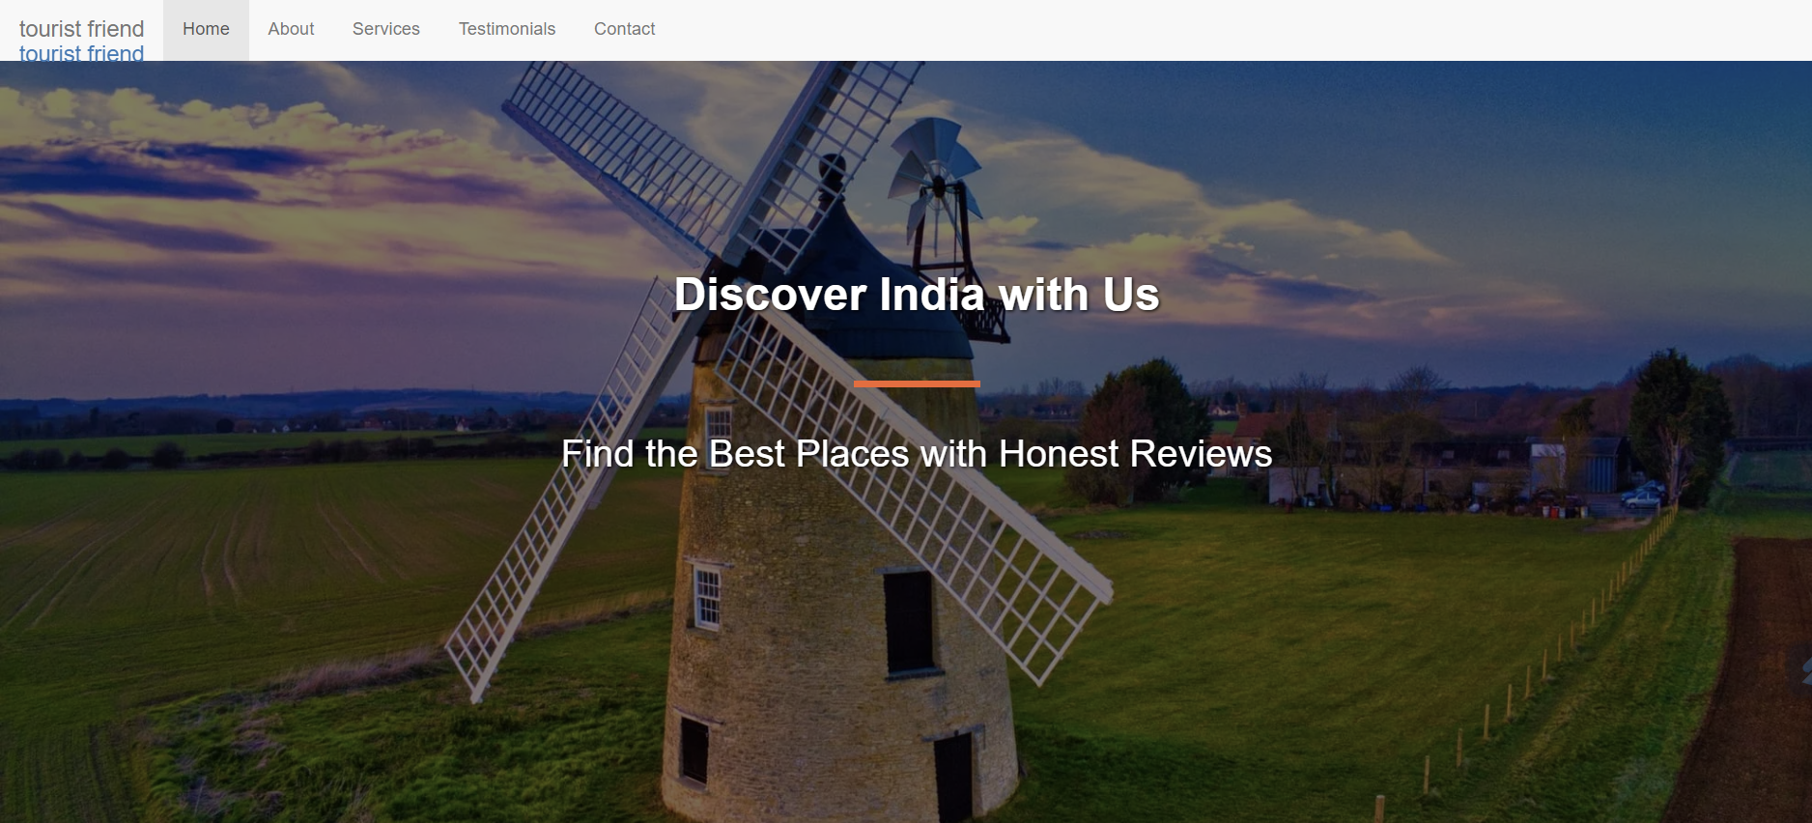
SCREEN SHOTS

Slide 18
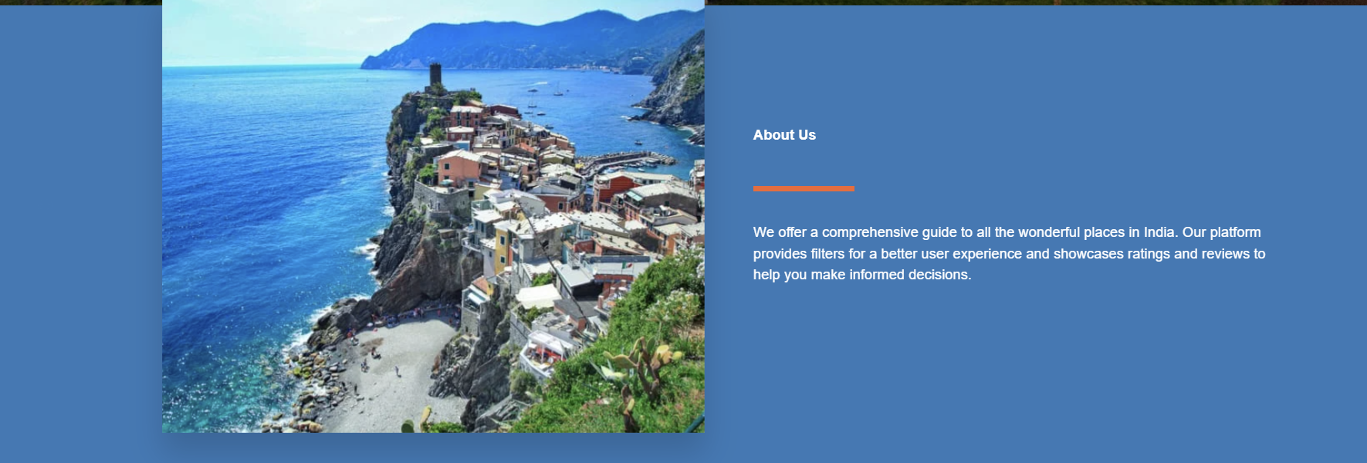

Slide 19
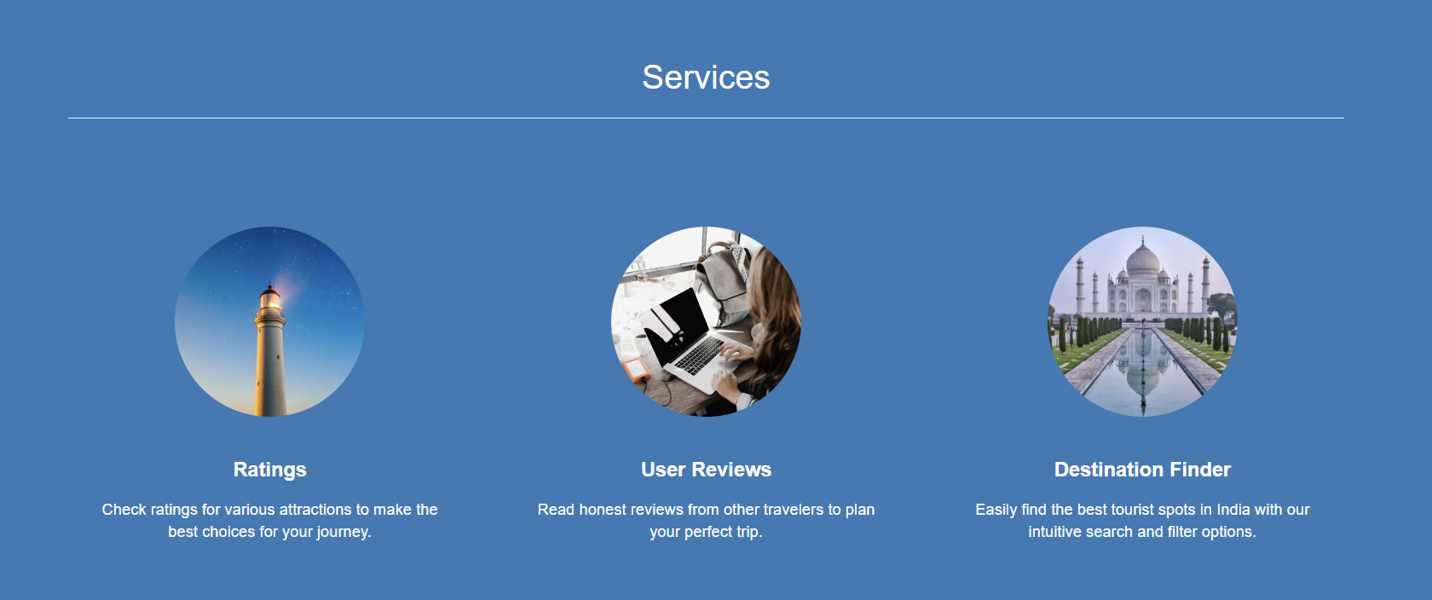

Slide 20
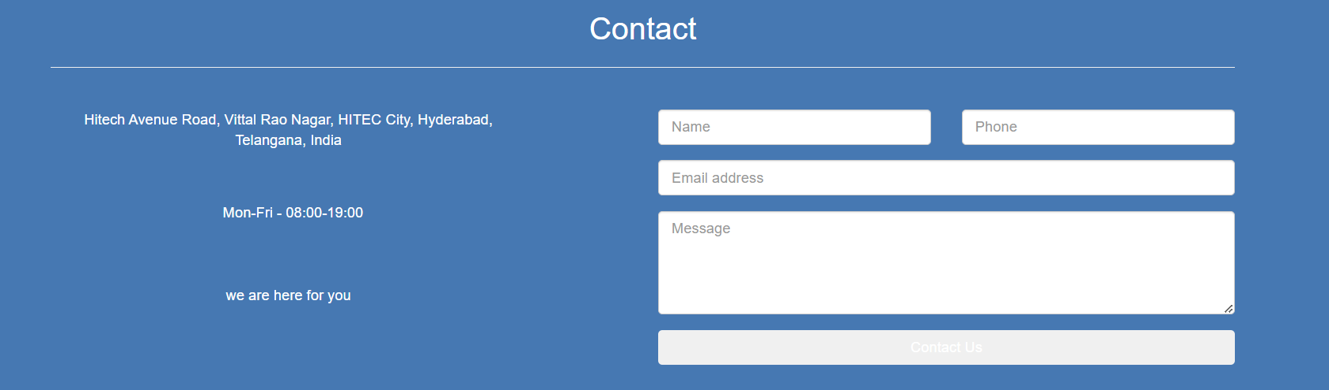

Slide 21
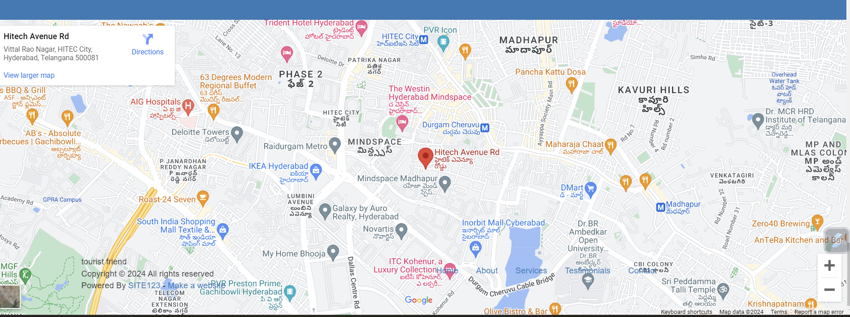

Slide 22
CONCLUSION
Tour Easy" aims to revolutionize the travel planning experience by addressing the common drawbacks of existing tour and travel websites. With its user-friendly interface, transparent pricing, advanced customization, reliable reviews, real-time updates, and robust customer support, "Tour Easy" is set to become the ultimate travel companion for modern travelers.
By offering comprehensive travel resources, integrated services, enhanced security, and promoting environmental and social responsibility, "Tour Easy" ensures that users can plan their trips efficiently, economically, and ethically

Slide 23


